Slide 1
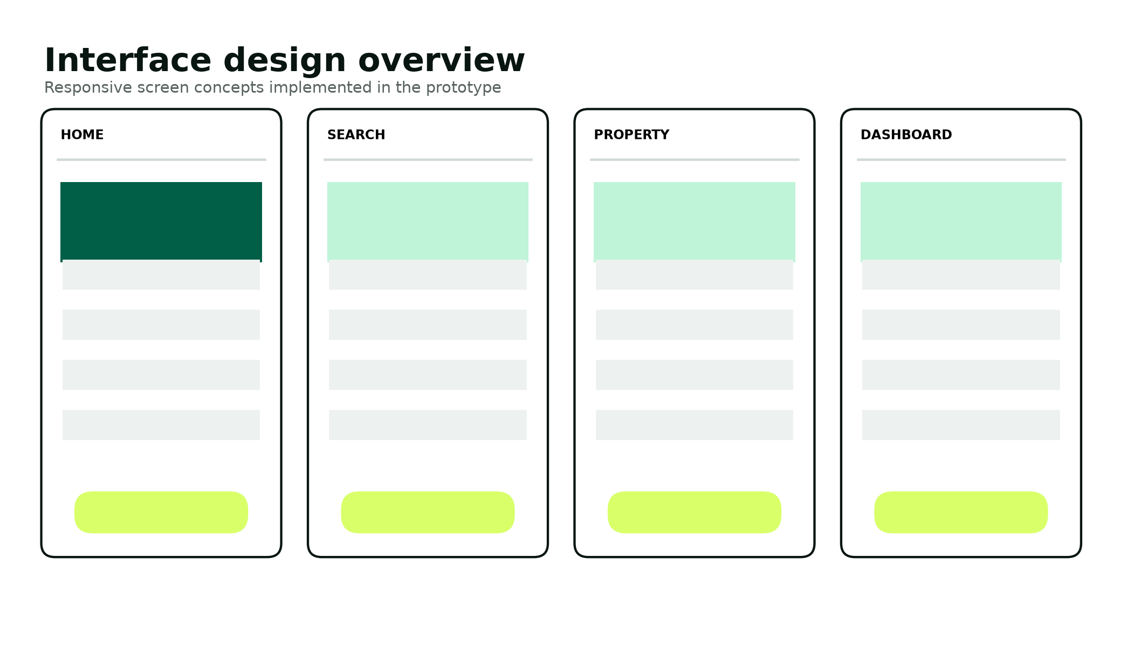
EMERGEX
Trust should not be
a scavenger hunt.
Centralized Student Accommodation & Secure Booking Application
IT PROJECT 700 • GROUP 55 • SEMESTER 2, 2026
Tristan Moses • Reenesh Ramawthar • Joyce Kamalu
Novithan Naidoo • Thingo Shezi • Lungelo Ngwane
Supervisor: Thabiso
Notes:
Speaker: Tristan
Open with the fragmented student journey and introduce EMERGEX as the single controlled path the team built.

Slide 2
PROBLEM
The housing gap is only half the problem
Students also carry the burden of fragmented discovery, unclear verification and disconnected deposits.
195,815
A typical student changes channel at every critical step
01
Discover
Marketplace, social post or institution list
estimated residence-bed shortfall in the 2011 ministerial review
02
Verify
Messages, screenshots and manual documents
03
Book
Forms, email or WhatsApp follow-up
04
Pay
Often outside the booking evidence trail
EMERGEX treats trust, status and evidence as product requirements—not informal hand-offs.
EMERGEX / GROUP 55 02
Notes:
Speaker: Tristan
Explain that capacity pressure creates urgency, but the software opportunity is the fragmented, hard-to-audit journey.
[Sources]
- https://www.dhet.gov.za/ResearchNew/39.%20Student%20housing%20at%20South%20African%20universities.pdf
- https://nsfas.org.za/content/studentacom.html
[/Sources]

Slide 3
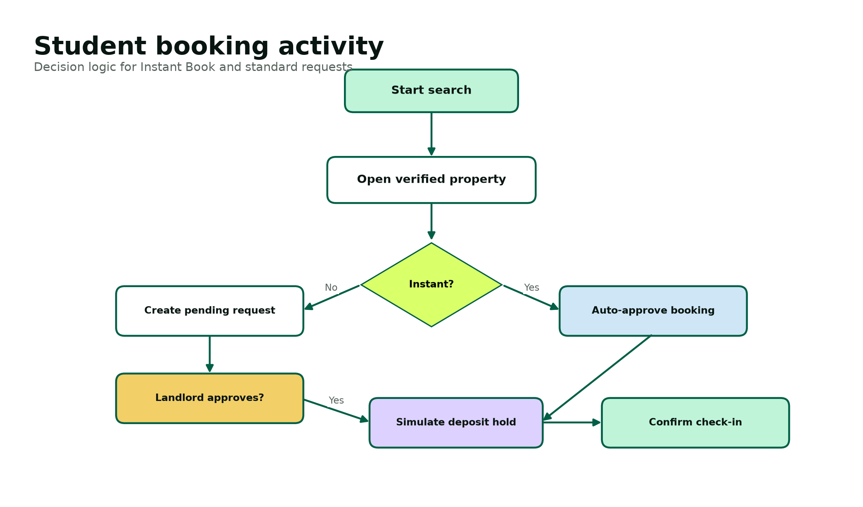
SOLUTION
One booking record carries the journey to check-in
Verified discovery, a visible decision deadline and a simulated protected-deposit lifecycle stay connected.
What changes
• Only verified, published listings appear
• Instant Book or a 12-hour response target
• One visible booking state machine
• Simulated hold and release after check-in
• Every critical action can be audited
EMERGEX / GROUP 55 03
Notes:
Speaker: Tristan
Walk from search to approval, deposit simulation and check-in. State explicitly that the prototype processes no real funds.

Slide 4
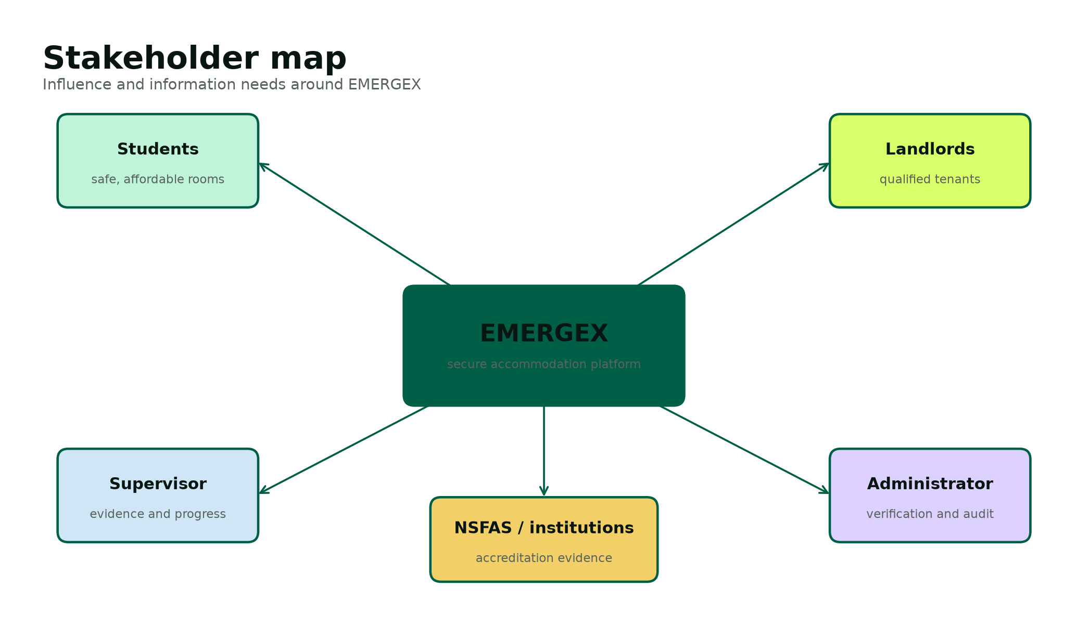
USERS
Three roles share one source of truth
Students decide, landlords respond and administrators verify—without crossing ownership boundaries.
STUDENT
Search, compare, book, upload evidence, track state
LANDLORD
Manage own listings and approve or reject owned requests
ADMINISTRATOR
Verify identities, properties and documents; inspect audit events
EMERGEX / GROUP 55 04
Notes:
Speaker: Joyce
Frame the role model as both a usability decision and a security boundary.

Slide 5
SCOPE
The academic MVP is intentionally bounded
The team demonstrates the complete workflow while keeping regulated production dependencies explicit.
SHIPS IN THE PROTOTYPE
REQUIRES PRODUCTION PARTNERS
Student, landlord and admin identity
Verified property search and filters
Standard and Instant Book paths
12-hour response deadline
Escrow lifecycle simulator
Validated demo-document review
MySQL schema, seed data and tests
Real payment collection or custody
Live NSFAS, bank or identity integration
Legally binding digital leases
Production chat, SMS or WhatsApp delivery
Real personal documents
Public hosting and penetration testing
Automated accreditation decisions
EMERGEX / GROUP 55 05
Notes:
Speaker: Joyce
Emphasize that scope control is a strength: the implementation proves business logic without pretending to be a regulated payment platform.

Slide 6
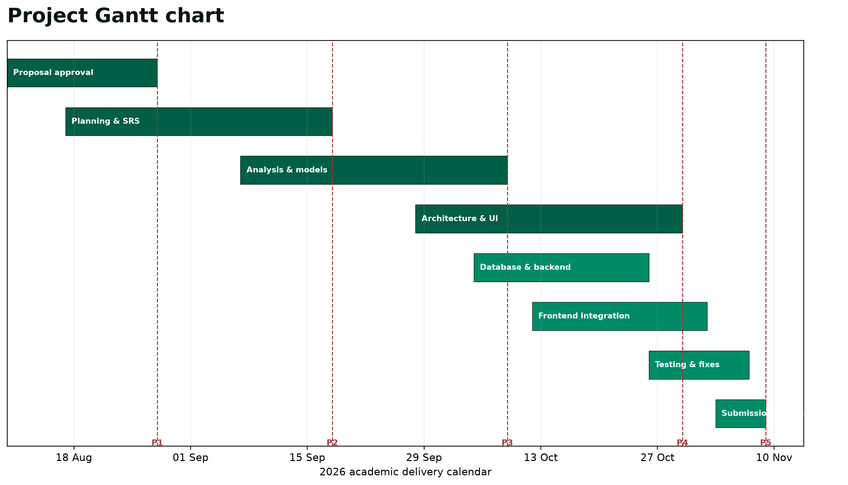
PLANNING
Five evidence gates keep the project reviewable
Waterfall aligns the academic submissions; short Agile sprints integrate the product inside each gate.
28 AUG
Proposal
18 SEP
Planning
09 OCT
Analysis
30 OCT
Design
09 NOV
Implementation
EMERGEX / GROUP 55 06
Notes:
Speaker: Joyce
Use the official dates as phase gates and explain how the PERT critical path protects database, backend, testing and final submission work.

Slide 7
TRACEABILITY
Every important requirement has a route to evidence
Stable identifiers connect stakeholder need, design, implementation and verification.
30
15
32
functional requirements
non-functional requirements
runtime test cases
FR-01 to FR-30
NFR-01 to NFR-15
ST-01 to ST-32
NEED → REQUIREMENT → DESIGN → PHP / SQL → TEST EVIDENCE
Example: FR-17 / one escrow record per booking / UNIQUE booking_id / book.php / ST-18
EMERGEX / GROUP 55 07
Notes:
Speaker: Reenesh
Show one traceability example and explain that the identifiers make change review and assessment questions easy to answer.

Slide 8
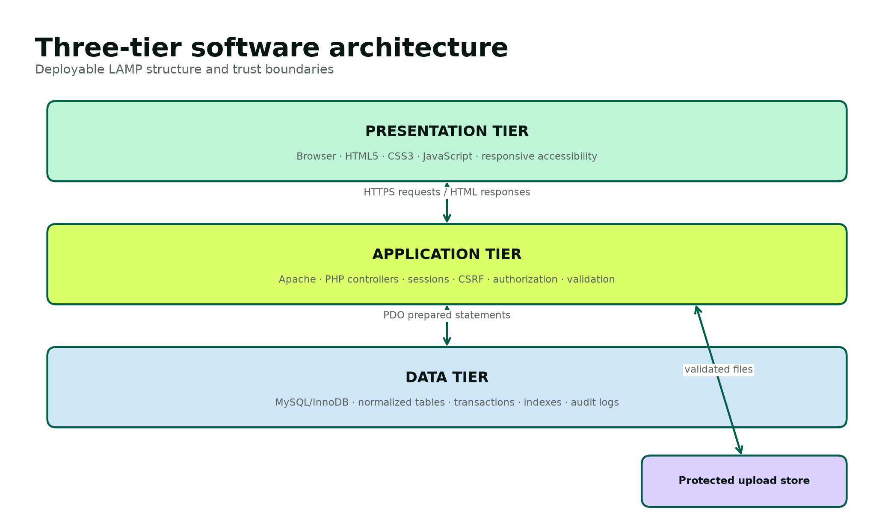
ARCHITECTURE
A simple three-tier design keeps controls visible
Shared PHP services centralize sessions, CSRF, authorization, escaping, database access and audit recording.
PRESENTATION
HTML5 • CSS3 • JavaScript
APPLICATION
Apache • PHP 8 • shared security helpers
DATA
MySQL/InnoDB • transactions • indexes
FILES
Validated demo uploads outside executable paths
EMERGEX / GROUP 55 08
Notes:
Speaker: Reenesh
Explain why the team chose explicit server-rendered pages: fewer dependencies, visible control flow and easy XAMPP deployment.

Slide 9
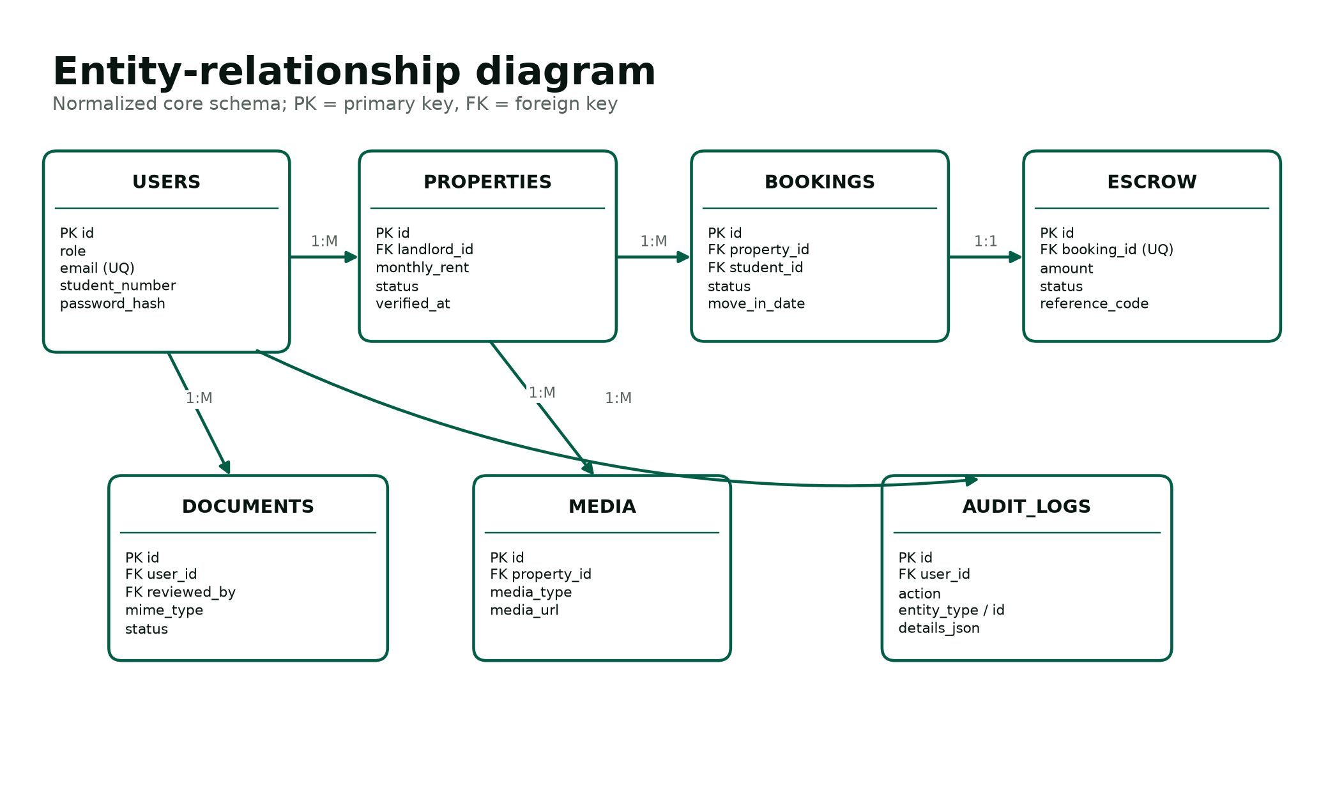
DATA DESIGN
The database enforces the workflow, not just storage
Seven normalized tables and eight foreign keys preserve ownership, history and one-to-one escrow state.
7 TABLES
users • properties • media • bookings • escrow • documents • audit
8 FOREIGN KEYS
Ownership and lifecycle integrity
ATOMIC CHANGES
Booking + escrow updates commit or roll back together
AUDIT EVIDENCE
Actor, action, entity and time
EMERGEX / GROUP 55 09
Notes:
Speaker: Reenesh
Point out the transaction snapshot fields on bookings and the unique booking link on escrow_transactions.

Slide 10
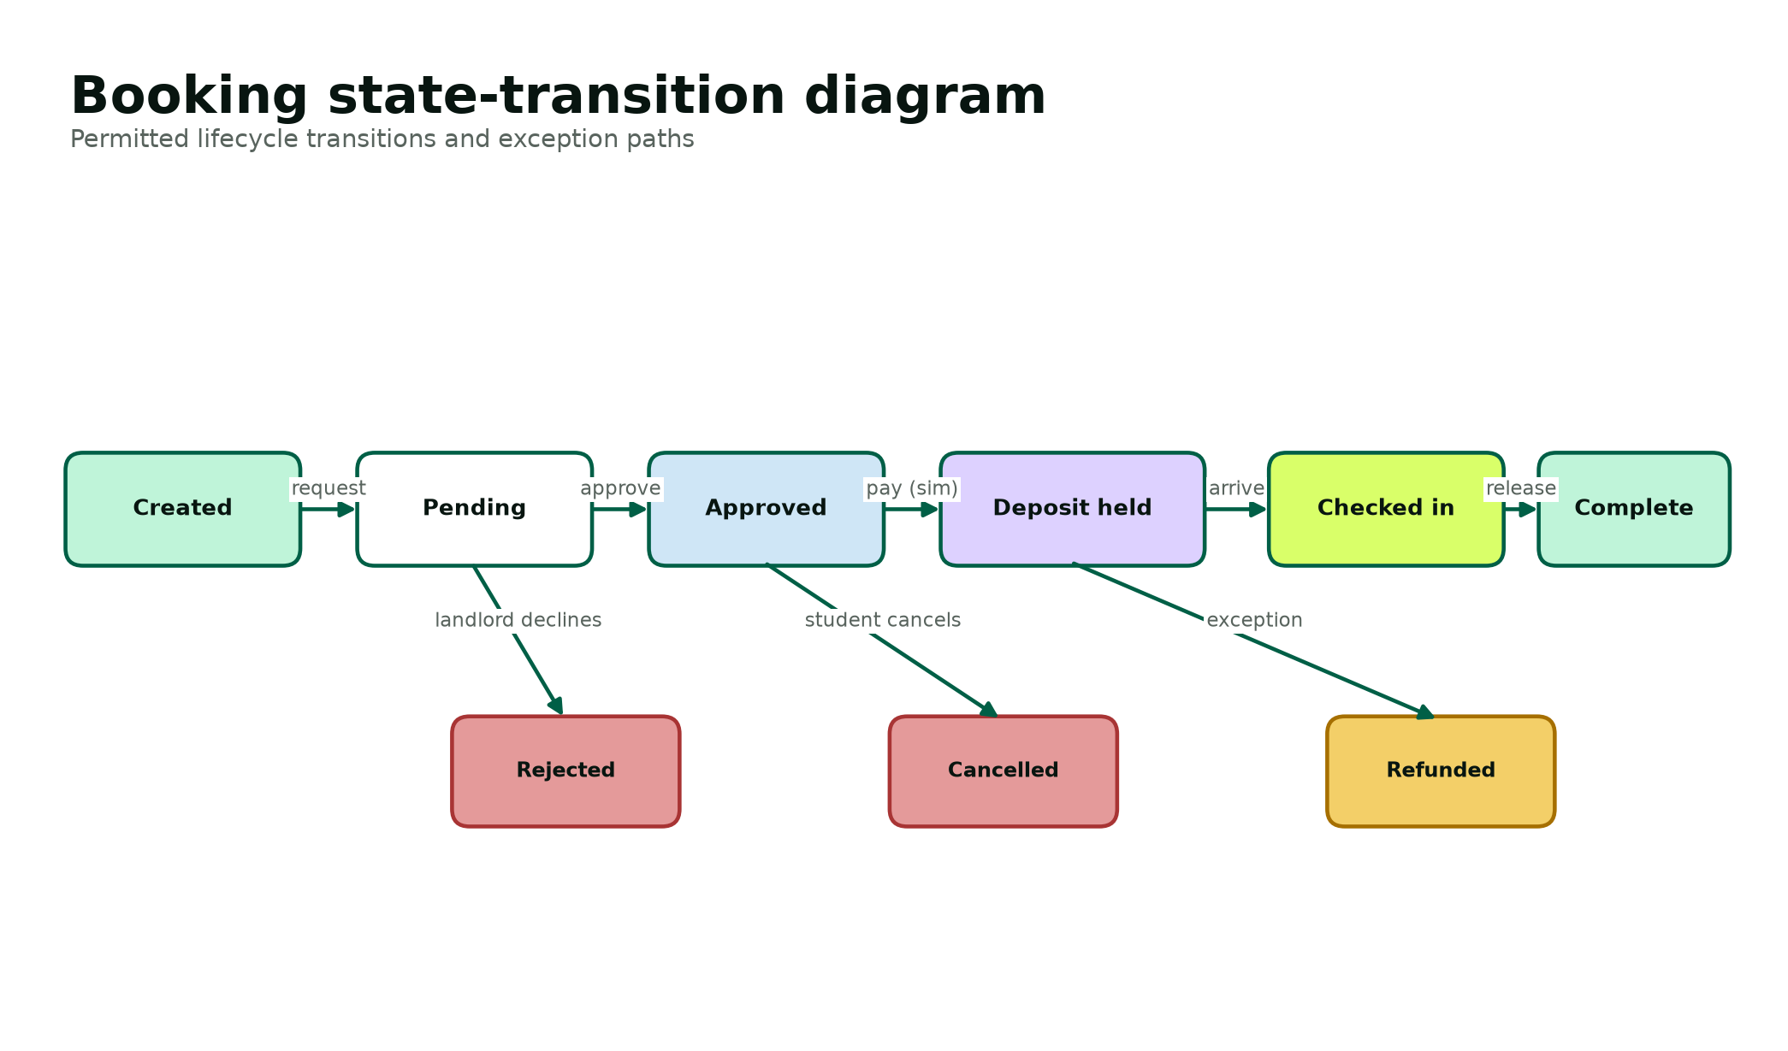
CORE WORKFLOW
The booking state machine prevents ambiguous actions
Only permitted server-side transitions can approve, hold, release, reject, cancel or refund a booking.
SAFETY BOUNDARY
No real money is collected, held or released.
The escrow record demonstrates state, reference generation and auditability only.
Production payment handling requires a licensed provider and legal review.
EMERGEX / GROUP 55 10
Notes:
Speaker: Reenesh
Walk through the happy path and one exception path. Reiterate the financial-simulator boundary.

Slide 11
EXPERIENCE
The interface makes status legible at every step
A responsive family of home, search, property and dashboard screens serves the same role-aware design language.
VISIBLE TRUST
Verification, NSFAS and Instant Book indicators
VISIBLE COST
Rent, deposit and availability together
VISIBLE STATE
Pending, approved, held and complete
RESPONSIVE
Designed from 360 px to desktop
EMERGEX / GROUP 55 11
Notes:
Speaker: Novithan
Describe the interface family and connect each screen to a primary task, not a decorative page.

Slide 12
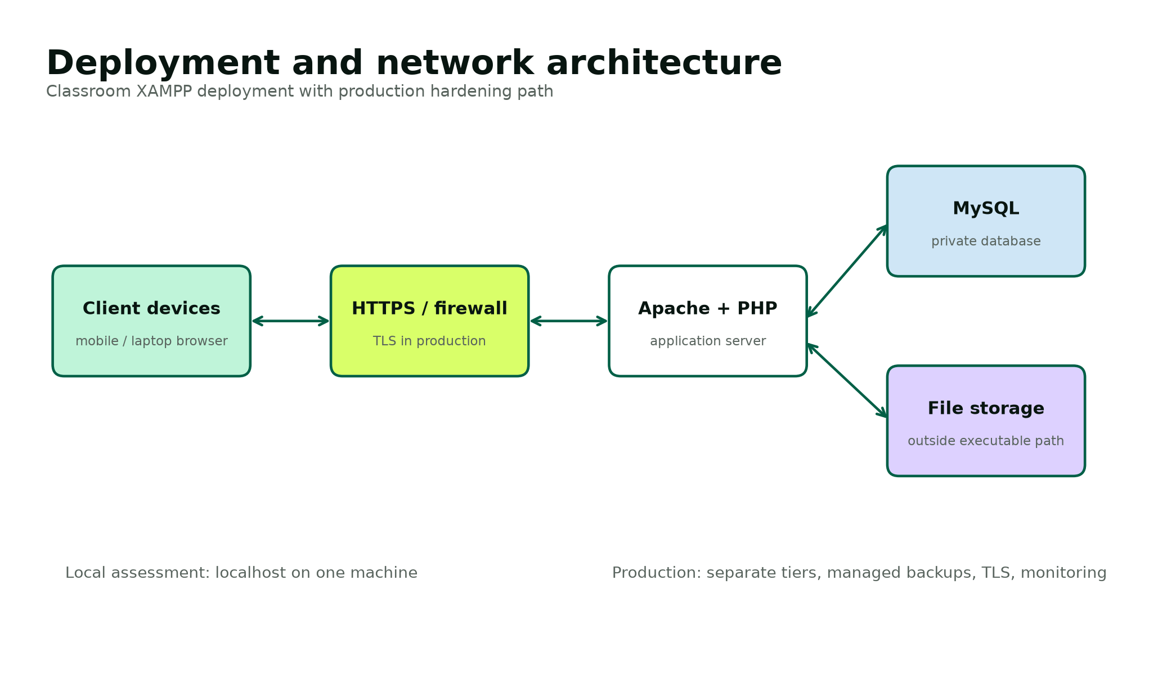
SECURITY
Security is layered across identity, requests, data and files
Preventive controls are backed by audit evidence and explicit production-hardening requirements.
PASSWORDS
password_hash / password_verify
DATABASE
PDO prepared statements + InnoDB constraints
REQUESTS
Session rotation + CSRF validation
ACCESS
Server-side roles and ownership predicates
FILES
MIME and size allow-list + random names
OUTPUT
Contextual escaping + restrictive CSP
EMERGEX / GROUP 55 12
Notes:
Speaker: Novithan
Explain the defense layers and distinguish the completed academic controls from future TLS, WAF, managed secrets, backups and penetration testing.
[Sources]
- https://www.php.net/manual/en/function.password-hash.php
- https://www.php.net/manual/en/pdo.prepare.php
- https://cheatsheetseries.owasp.org/cheatsheets/Authentication_Cheat_Sheet.html
- https://www.justice.gov.za/legislation/acts/2013-004.pdf
[/Sources]

Slide 13
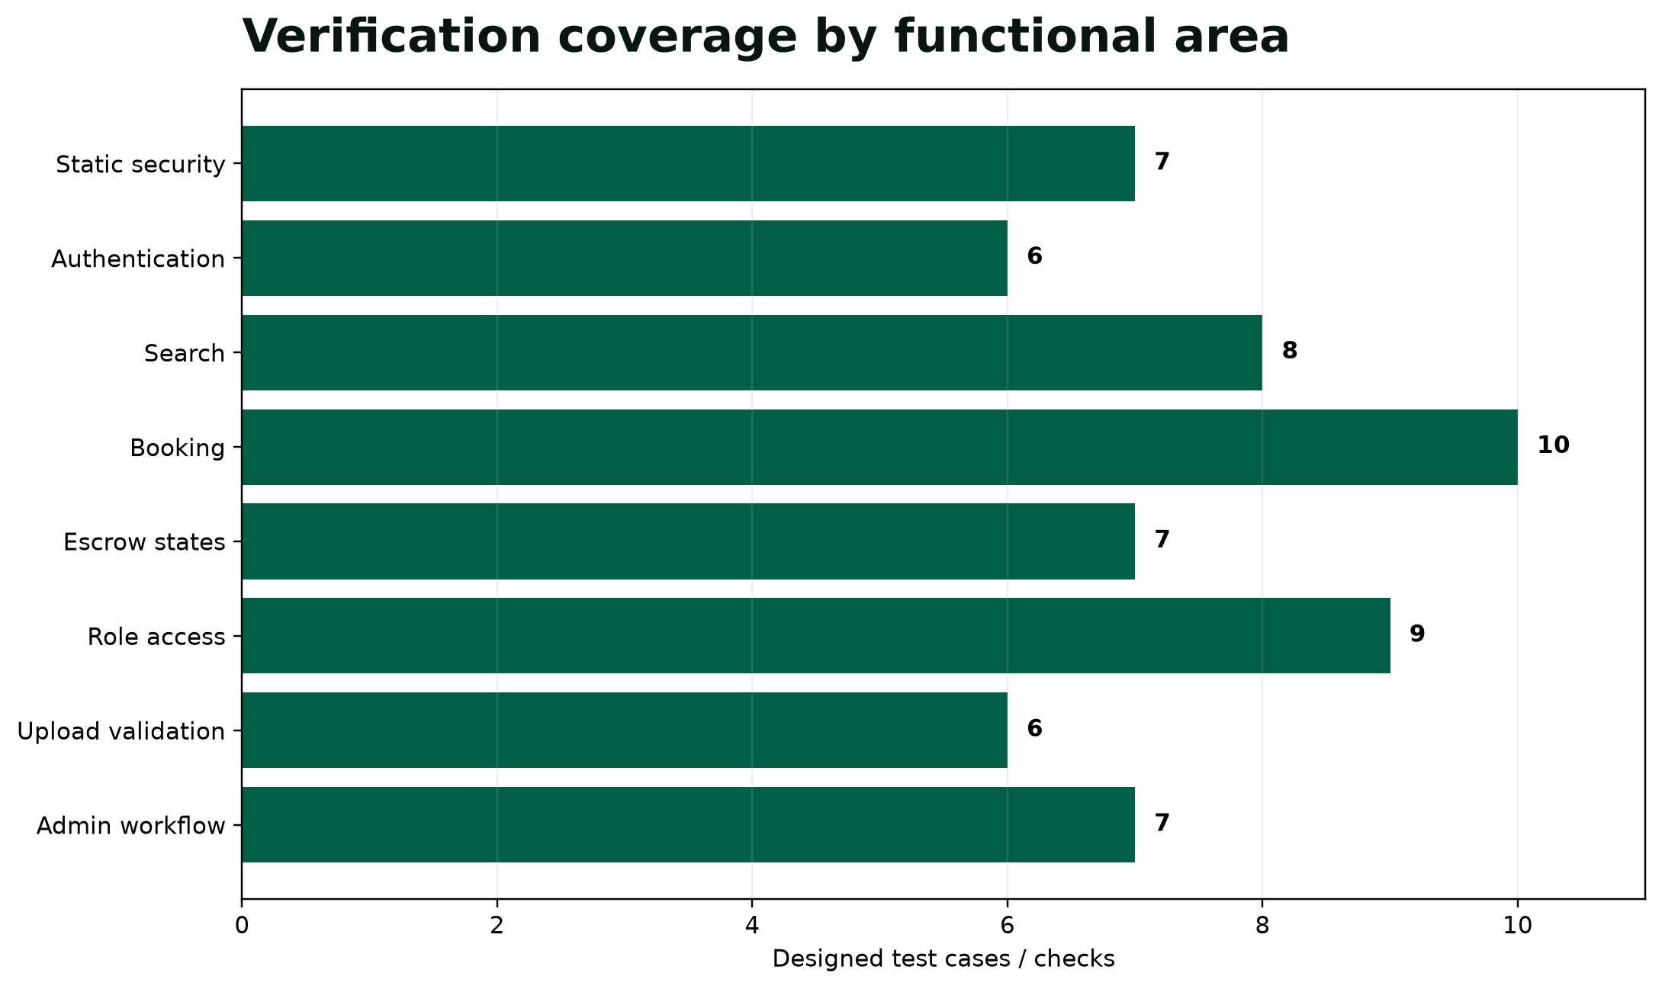
VERIFICATION
The complete acceptance baseline is verified
XAMPP runtime, security, syntax and responsive browser evidence are all preserved in the package.
21
PHP files
37
prepared-query calls
13
public workflow pages
32
runtime test cases
STATUS
32 / 32
ACCEPTANCE PASS
7 / 7 security checks
21 / 21 syntax checks
3 / 3 browser cases
EMERGEX / GROUP 55 13
Notes:
Speaker: Lungelo
State the verified results and point the panel to the machine-readable evidence. Explain that these results support academic acceptance of the local prototype, not production certification.

Slide 14
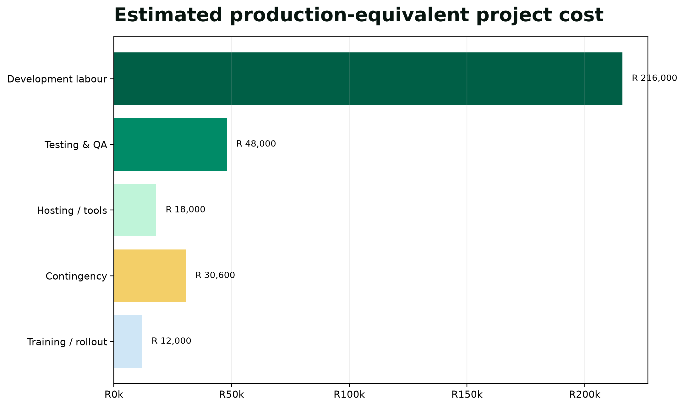
FEASIBILITY
Academic delivery is low-cost; production value needs proof
A transparent bottom-up estimate separates development effort from hosting, rollout and contingency.
R324,600
illustrative production-equivalent baseline
Illustrative benefit model
600 verified placements
× R750 average success fee
= R450,000 gross revenue
Less R150,000 operating allowance
≈ 13-month development recovery
Academic feasibility model—not an investment forecast.
EMERGEX / GROUP 55 14
Notes:
Speaker: Lungelo
Explain assumptions and exclusions. The model is useful because it is editable and transparent, not because it predicts adoption.

Slide 15
DEMONSTRATION
The panel can verify the complete journey in ten moves
A timed 15-minute live demonstration covers the database, security, reporting and recovery controls.
1 Start XAMPP and show the database
2 Search and filter verified homes
3 Book and hold a simulated deposit
4 Approve a request as landlord
5 Complete check-in and release
6 Review verification and audit as admin
7 Upload and decide a demo document
8 Generate, print and export reports
9 Show security controls and evidence
10 Retrieve the tested SQL backup
student@emergex.test / Student@55 • landlord@emergex.test / Landlord@55 • admin@emergex.test / Admin@55Secure
EMERGEX / GROUP 55 15
Notes:
Speaker: Thingo
Use the supplied 15-minute runbook. Each member demonstrates their owned control and can explain one neighbouring module. Keep the report PDF, SQL backup and a second offline project copy available as fallback evidence.

Slide 16
EMERGEX / GROUP 55
E
M
E
R
G
E
X
Centralized. Secure.
Traceable from need to test.
The complete project package is installed, tested and presentation-ready. The remaining human controls are a timed group rehearsal, supervisor approval and individual Moodle submission by every member.
NEXT: REHEARSE → APPROVE → BACK UP → SUBMIT
Tristan • Reenesh • Joyce • Novithan • Thingo • Lungelo
Notes:
Speaker: Thingo
Resolve the opening: EMERGEX replaces a scavenger hunt with one visible, controlled journey. Invite panel questions by requirement, design, code or test evidence.

